Slide 1

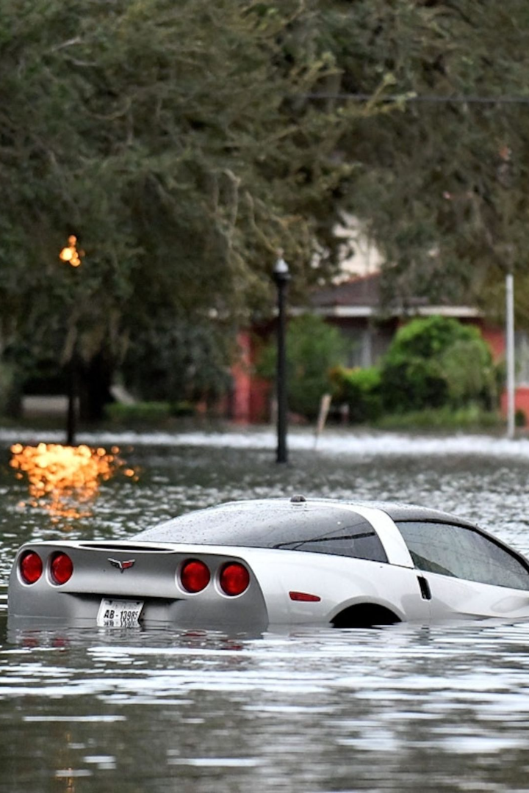
Floodings in Slovakia
Slovakia has a long history of flooding, causing immense damage to infrastructure and affecting thousands of people. In this presentation, we'll explore the extent of the damage caused by flooding, weather conditions, the anti-flooding measures in place, and the locations, rivers that have been most problematic. Also we gona have a look at future investment from EU for the anti-flooding systems.

Slide 2
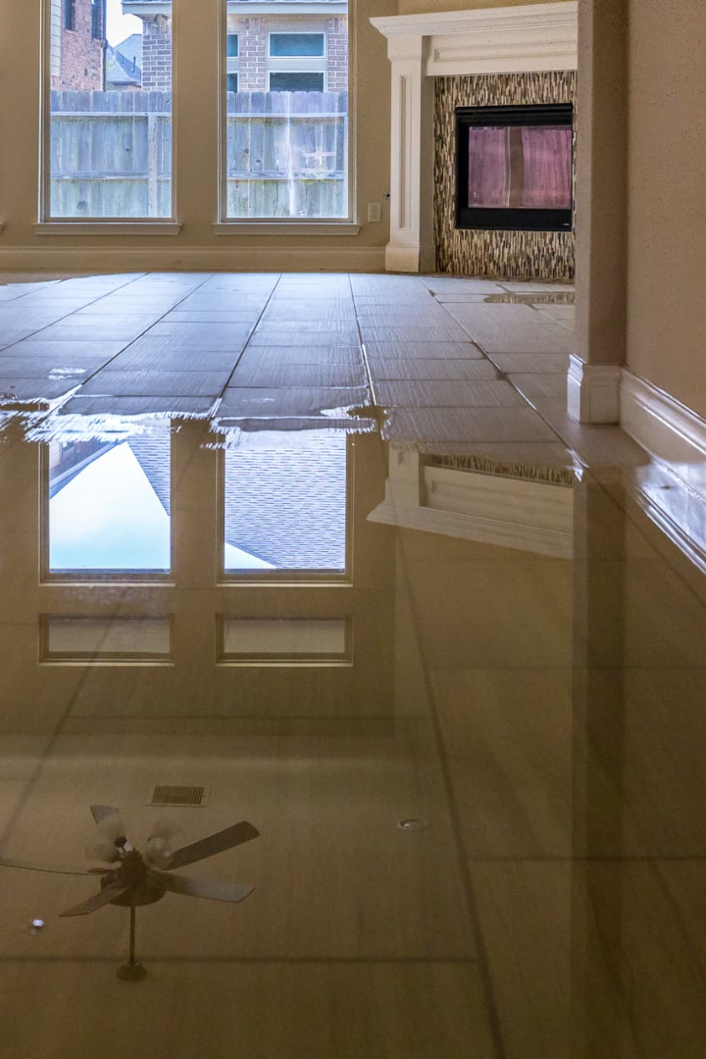
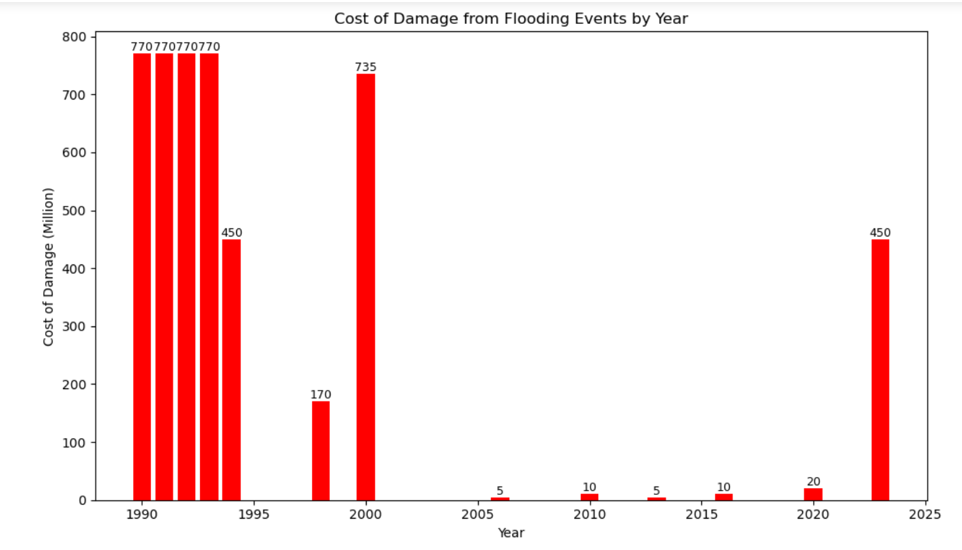
The Cost of the Damage
Since 1990, flooding has caused €4.9 billion in damage in Slovakia. This includes the cost of repairing infrastructure like roads and bridges, as well as the loss of crops and other resources. It is clear that flooding is a major issue that needs to be addressed.

Slide 3
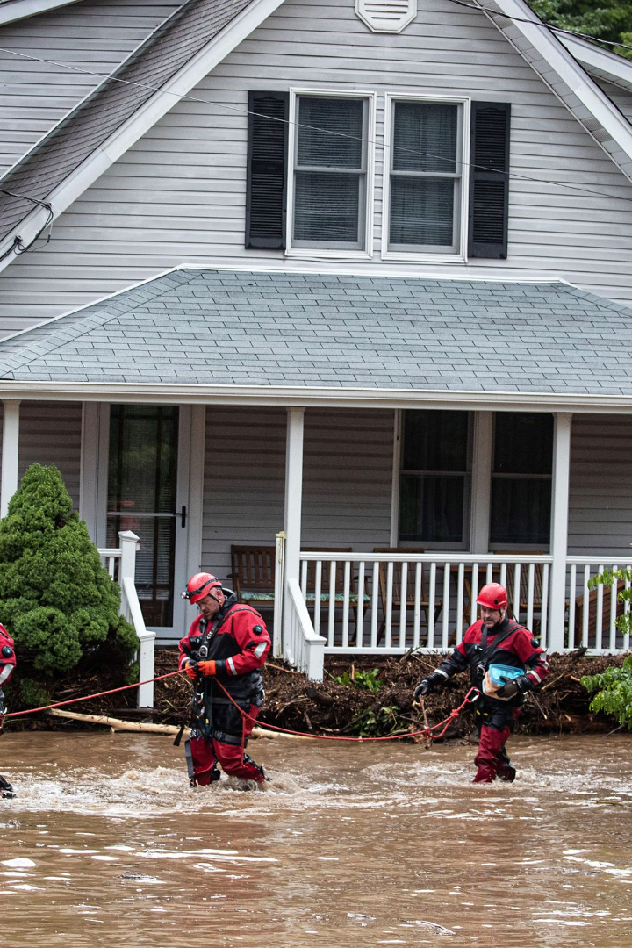
The Number of People Affected
Over the last three decades, a staggering 493,500 people have been affected by flooding in Slovakia. This number includes those who have been displaced from their homes, those who have lost their possessions, and those who have suffered injuries or worse. The impact of flooding on people's lives cannot be overstated.

Slide 4
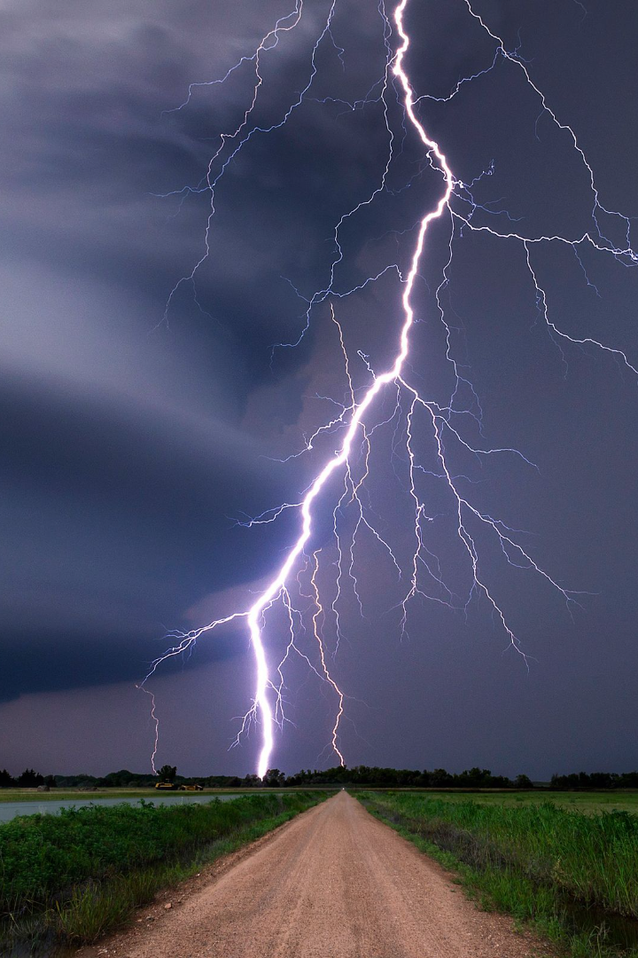
Weather Patterns During Flooding
During flooding, Slovakia has experienced intense rainfall ranging from 40-100mm. These weather patterns have led to flash floods that have overwhelmed the capacity of many rivers and streams. Understanding these patterns is key to predicting and mitigating the effects of flooding in the future.

Slide 5
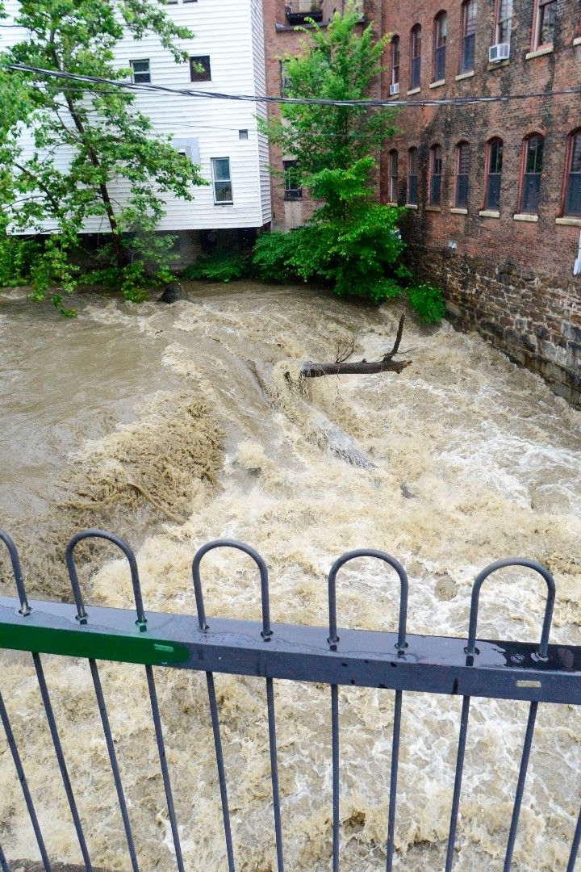
The Number of Floodings
Since 1990, Slovakia has experienced 63 floodings. The majority of these were concentrated around rivers such as Laborec, Ondava, and Vah. Understanding where flooding is most likely to occur is crucial for designing effective anti-flooding systems.

Slide 6



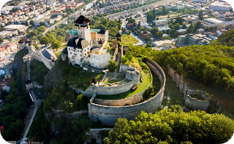
The Locations of the Floodings
Banska Bystrica
Zilina
Bratislava
Trencin
This central Slovakian city is located near the Hron River, which has caused flooding in the past.
Located in the northwestern part of the country, Zilina has experienced multiple floodings over the last three decades.
The capital and largest city of Slovakia, Bratislava has faced the threat of flooding for many years due to its position on the banks of the Danube River.
This city in western Slovakia has been hit hard by flooding over the years.

Slide 7
The Rivers Which Caused Most of the Floodings
Laborec
Ondava
Vah
The Laborec River in eastern Slovakia has been responsible for numerous floodings, prompting the construction of anti-flooding measures in the area.
The Ondava River has also caused significant flooding in Slovakia over the years, leading to the construction of levees, dams, and retention ponds in the area.
The Vah River, which flows through western Slovakia, is still a major concern. Construction of the anti-flooding system is ongoing, with an expected cost of €500 million.

Slide 8
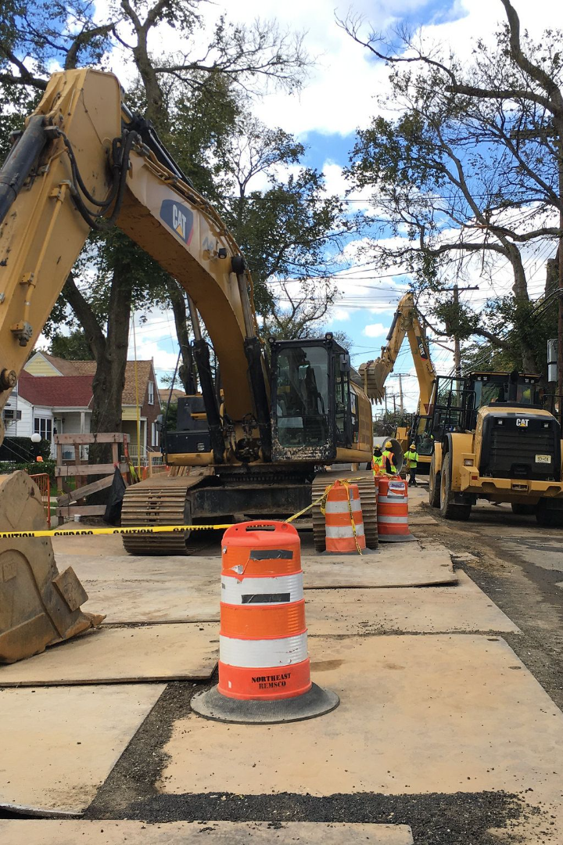
The Cost of Anti-Flooding Systems
The Slovak government has spent over €1.5 billion on anti-flooding systems since 1990. This includes the construction of levees, dams, and retention ponds, as well as the improvement of river channels. Investment in anti-flooding measures has increased substantially over the decades, with spending of €200 million between 1990 and 2000, €500 million between 2001 and 2010, and €800 million between 2011 and 2020. This investment has been crucial for protecting people and infrastructure from flooding.

Slide 9

EU Funding for Anti-Flooding Projects
The Slovak government has received funding from the European Union for anti-flooding projects, particularly between 2007-2013. During this period, the EU provided €200 million for anti-flooding measures in Slovakia. This support from the EU has been vital in helping Slovakia to combat the effects of flooding.

Slide 10

Future Investment in Anti-Flooding Systems
The Slovak government is committed to continuing to invest in anti-flooding systems, given the likelihood of future flooding events. It is estimated that the country will need to spend an additional €1 billion on anti-flooding measures in the next 10 years to ensure the safety of its citizens.

Slide 11
Anti-Flooding Constructions Next to Rivers
Anti-flooding systems can take various forms, such as levees, dams, and retention ponds. Here we highlight several important systems that have been built to prevent flooding:
River
Cost (€)
Year of Construction
Laborec
200 million
1990s-2000s
Ondava
100 million
2000s
Vah
500 million
Ongoing
Danube (Slovakia)
1 billion
Underway
Hron
200 million
1990s-2000s
Nitra
100 million
2000s
Orava
500 million
Ongoing
Danube (joint project Slovakia and Hungary)
1 billion
Underway

Slide 12
Thank you
CREATE BY: MICHAL UHRINEK
LINKEDLN:https://www.linkedin.com/in/michal-uhrinek-b61666154/
GITHUB:https://github.com/michaluhrinek/Data-Analyst-Portfolio-SQL-R-
Python-EXCEL/tree/main/Python-Floodings%20in%20Slovakia

Slide 13
.
DATA

Slide 15
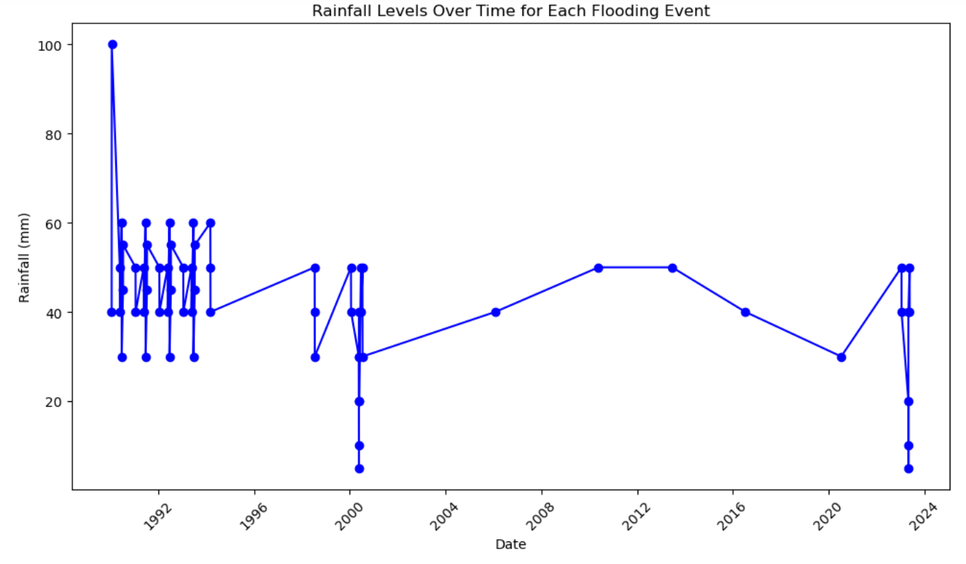

Slide 16
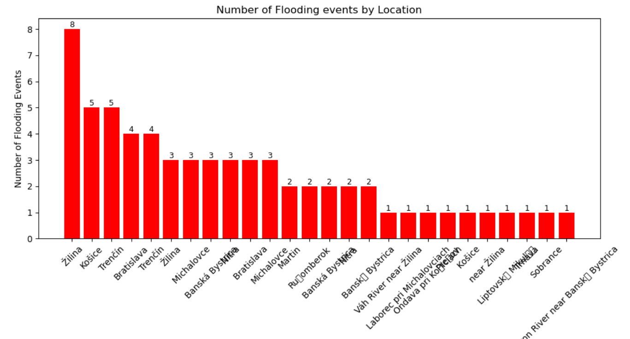

Slide 17
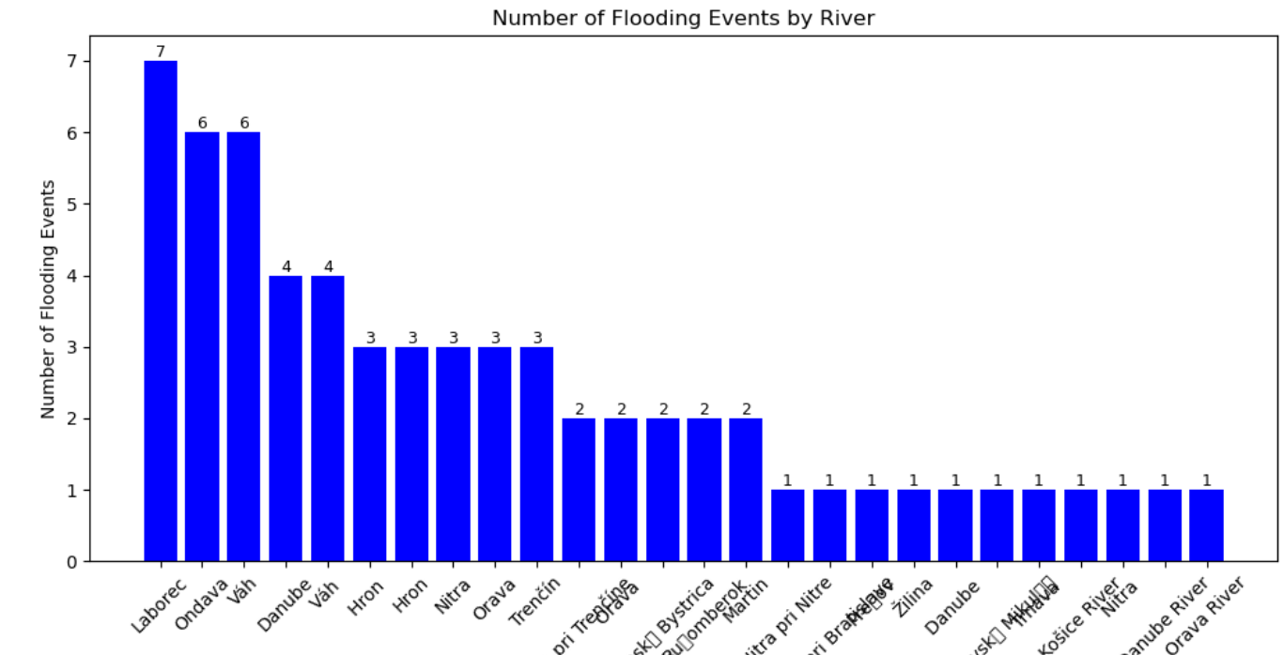

Slide 18
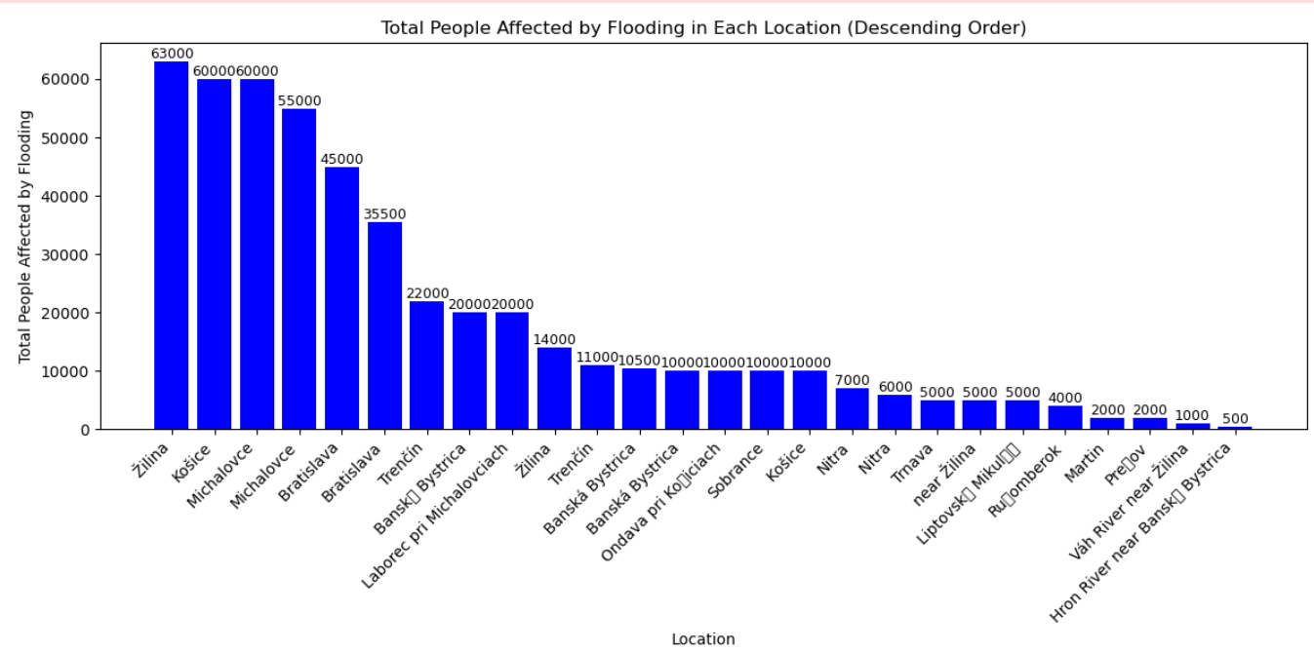

Slide 19
END

